Slide 1


Introduction to Ngrx
Timmy K Tom Tata Consultancy Services

Slide 2




About me

Slide 3
Ngrx
RxJS powered state management for Angular applications, inspired by Redux.
Three main pieces of Ngrx : single store, reducers, actions.
The primary characteristics is that state is centralized, events flow up and state flows down.

Slide 4
Basic flow
reducers
server
new state
http
store
actions
effects
services
App Component
Child Component
Child Component
dispatch

Slide 5
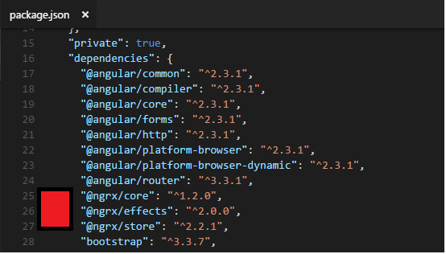
Install:
npm install @ngrx/core @ngrx/store @ngrx/effects --save
OR
npm install @ngrx/core --save
npm install @ngrx/store --save
npm install @ngrx/effects --save

Slide 6
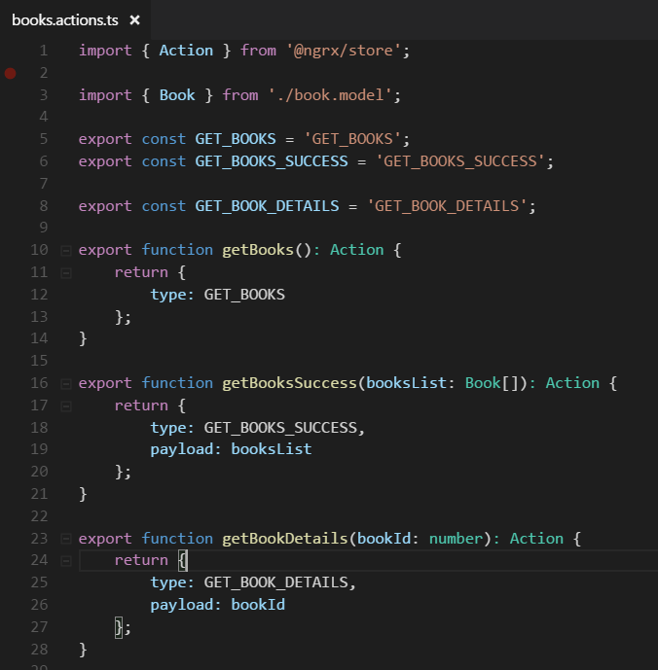
Actions
-> communicate to the Reducers when the state needs updated
‘Action’ is a simple interface that ngrx/store provides
It contains two properties:
'type' -> is a string, denoting what change in state has occurred.
'payload [Optional] ->' is a JavaScript object containing any data that is associated with that state change.

Slide 7
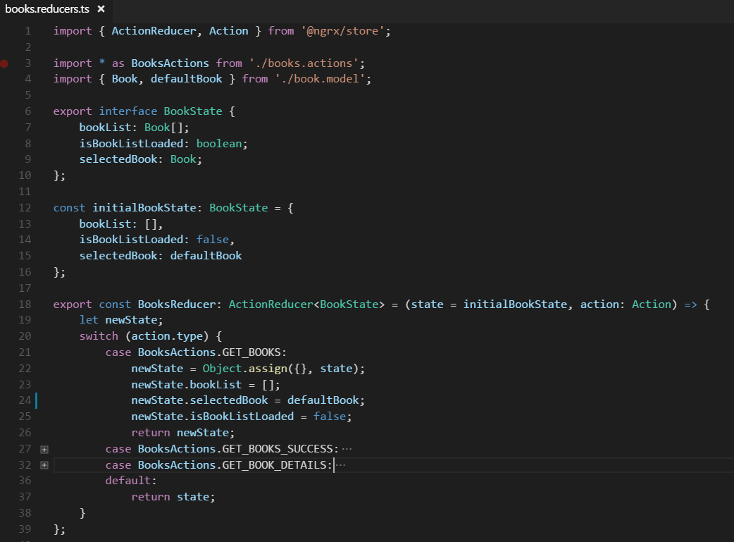
Reducers
-> It’s a pure function that given a state, and an action, will return a new state.

Slide 8
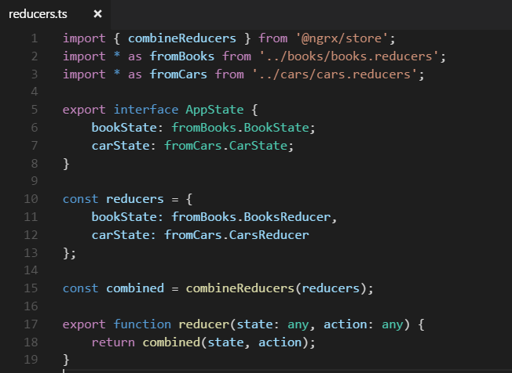
AppState and Combine all reducers
AppState interface is just a simple final representation of the state for the entire app. We’ll use this later when we are grabbing a reference to the store and selecting data from it.
Combine all the reducers and the parent reducer will invoke each child reducer with the previous slice of state and action each time an action is dispatched.

Slide 9
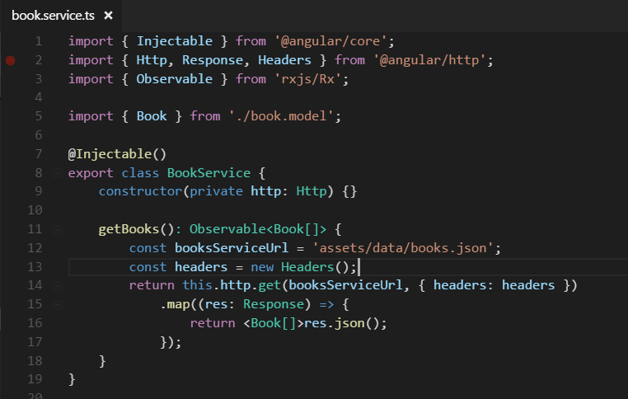
Service Class to communicate with server
Simple Typescript class and its public function return type is of Observable.

Slide 10
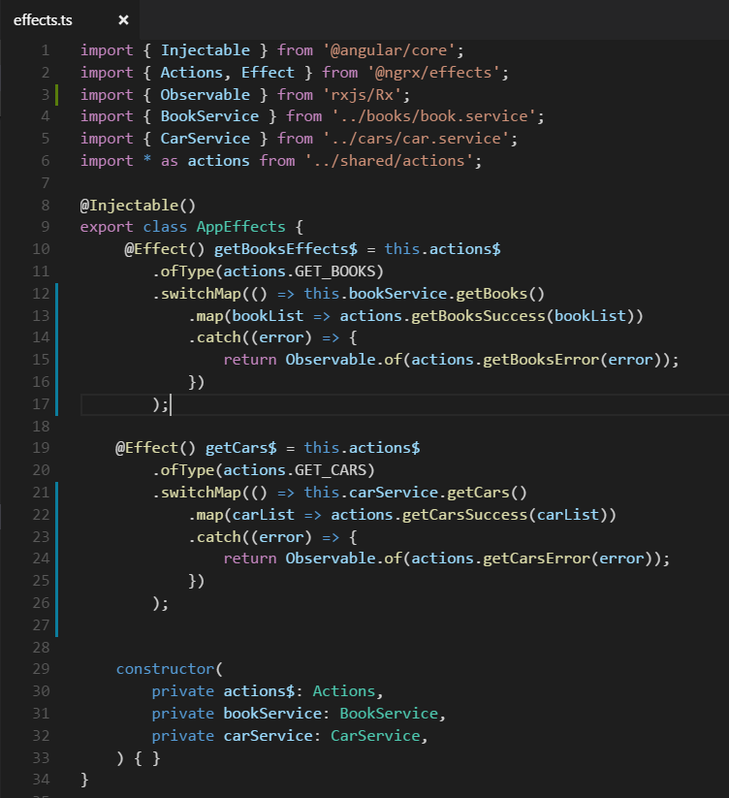
ngrx/effects
-> listens for actions being dispatched to the store and can generate a new action and dispatches it.
We subscribe to ‘this.actions$’ Observable and listen to actions ofType ‘GET_BOOKS’ or ‘GET_CARS’.
Then we call switchMap on that as we’re going to get a whole new observable from the service.
The subsequent map call then operates on a list of books/cars from the service.
We pass that response list to respective success action.
Ngrx/effects then will take care of dispatching this new action to the store.

Slide 11
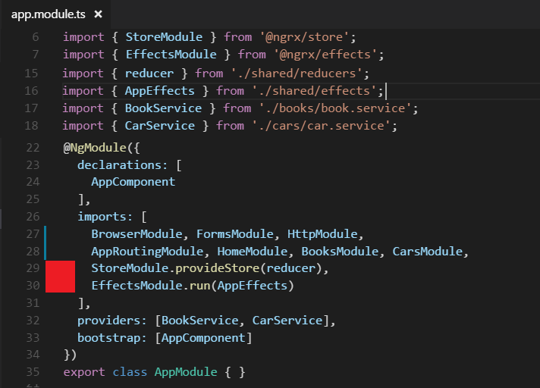
StoreModule & EffectsModule

Slide 12
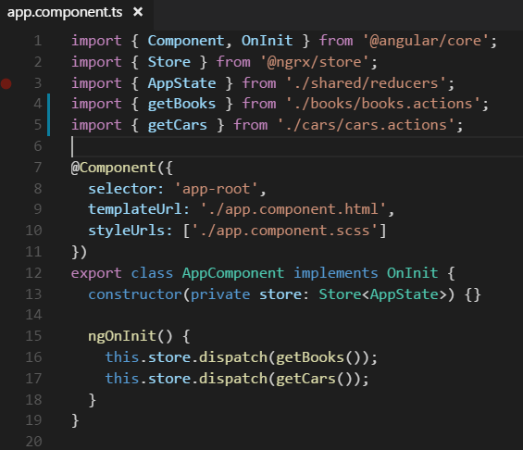
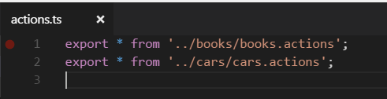
Dispatching action from a component
import { getBooks, getCars } from './shared/actions';
If we have multiple actions file, we can export all the actions in a common action file under shared folder.

Slide 13
Code walkthrough
https://github.com/timmyktom/angular2_ngrx_example

Slide 14
Thank You

